Slide 1
SI 608 Week 3 – Centrality Extra Content
Ceren Budak

Slide 2
Computing Betweenness Centrality
Challenge: reasoning about the set of all the shortest paths between pairs of nodes. => there could be many!
How can we efficiently compute betweenness without the overhead of actually listing out all such paths?
Let us focus on betweenness of edges this time (computing betweenness of nodes is trivial after that point)
Homework pointer: for a small graph your best bet is still to enumerate the pairs and identify the shortest paths
Steps are (for every node A):
Perform a breadth-first search of the graph, starting at A.
Determine the number of shortest paths from A to each other node.
Based on these numbers, determine the amount of flow from A to all other nodes that uses each edge.

Slide 3
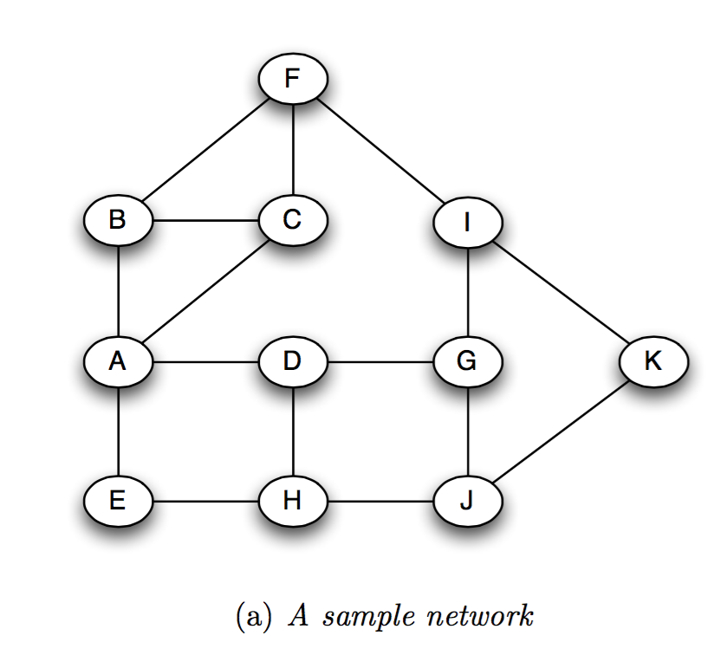
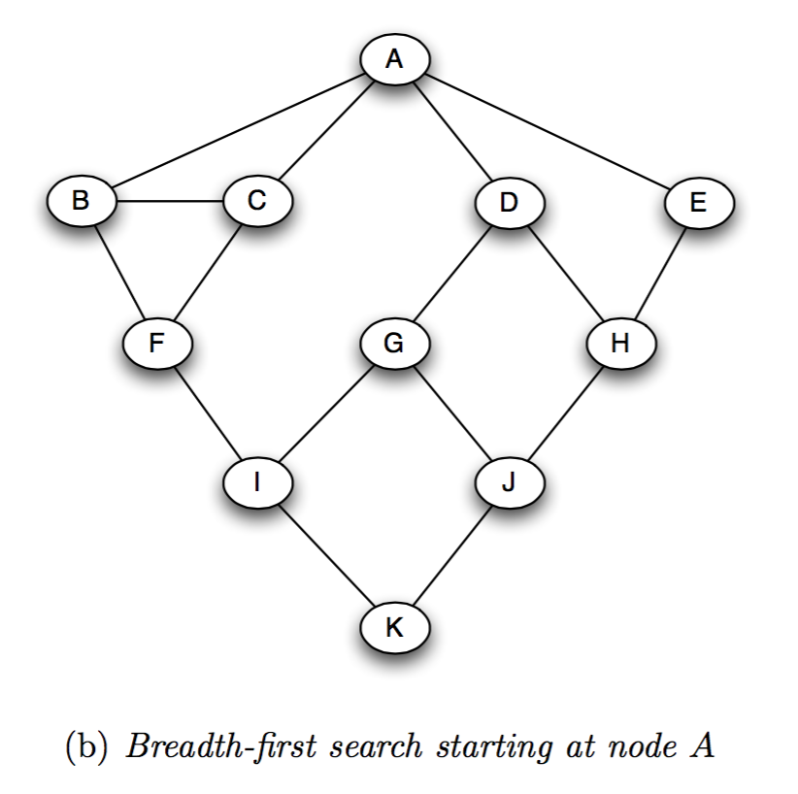
Computing Betweenness Centrality
Steps are (for every node A):
Perform a breadth-first search of the graph, starting at A.

Slide 4
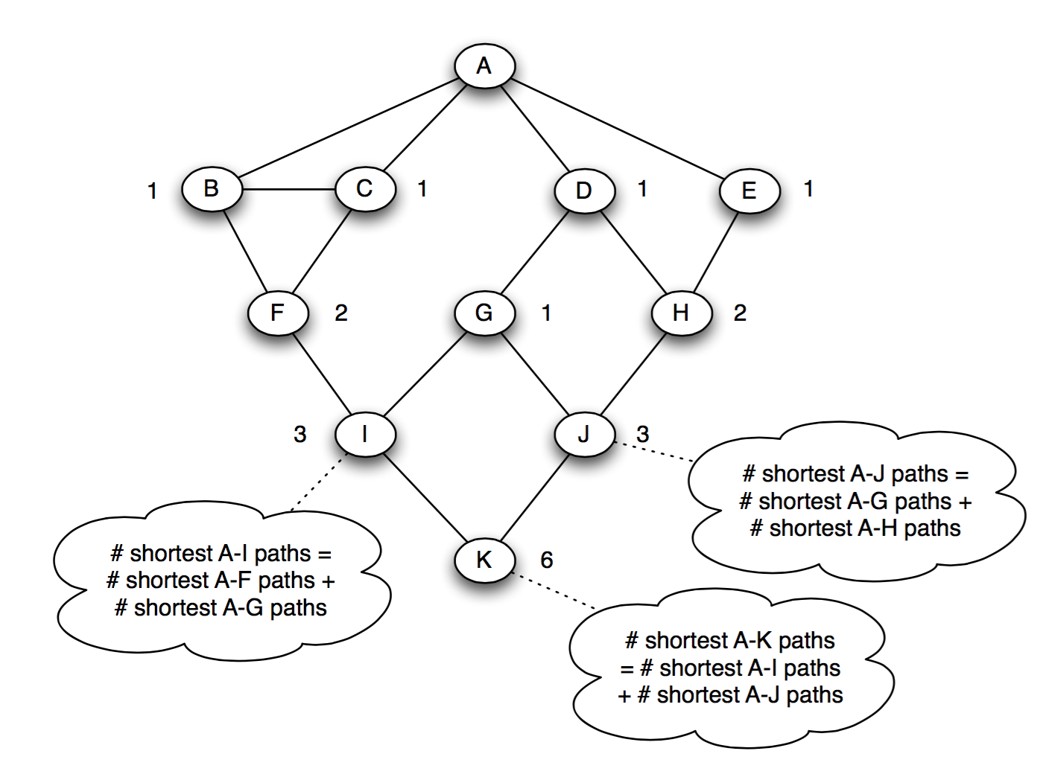
Computing Betweenness Centrality
Steps are (for every node A):
Perform a breadth-first search of the graph, starting at A.
Determine the number of shortest paths from A to each other node.

Slide 5
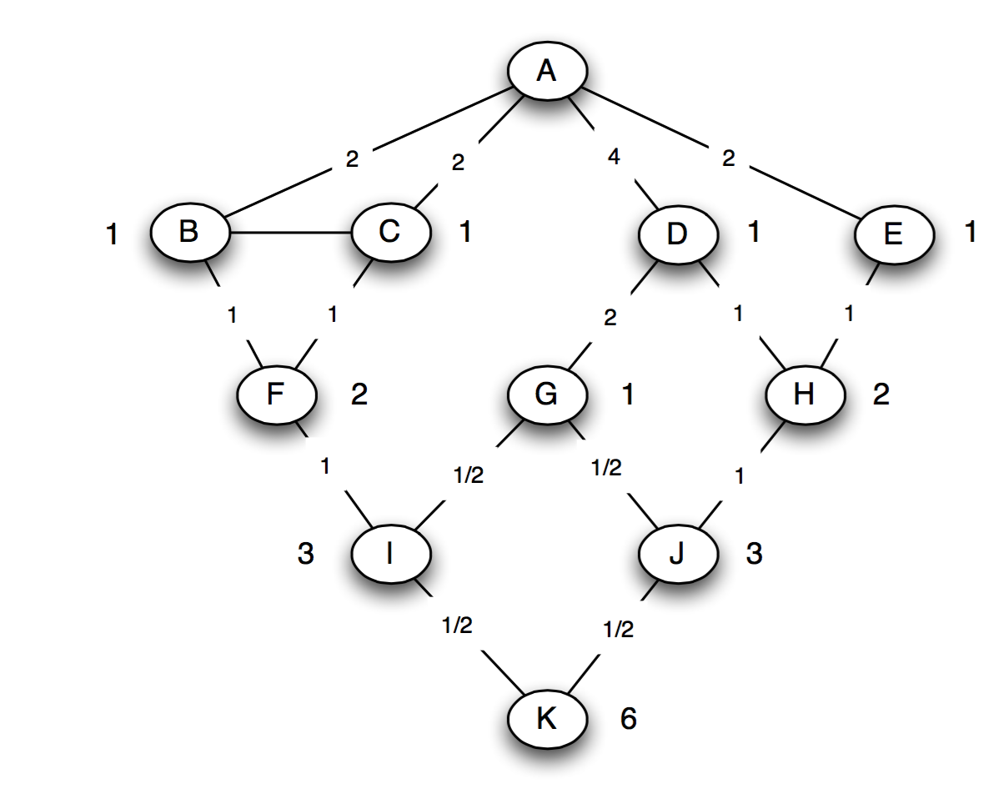
Computing Betweenness Centrality
Cost of
betweenness?
Steps are (for every node A):
Perform a breadth-first search of the graph, starting at A.
Determine the number of shortest paths from A to each other node.
Based on these numbers, determine the amount of flow from A to all other nodes that uses each edge.
Method: When we get to a node X in the breadth-first search structure, working up from the bottom, we add up all the flow arriving from edges directly below X, plus 1 for the flow destined for X itself. We then divide this up over the edges leading upward from X, in proportion to the number of shortest paths coming through each.
Notes:
BFS = O (V + E)
We need to do this for all nodes

Slide 6
Computing Betweenness Centrality
Remember that you need to perform BFS from each node in the graph and sum the values over all trees to find betweenness of an edge
Also note that we implicitly keep track of amount of flow through the nodes as well as edges. We can use these to measure betweenness of nodes

Slide 7
Bonacich Power Centrality
Intuition: Your centrality depends on your neighbors’ centrality (the more central your neighbors are, the more central you are)
3
2
1
4
5
degree of i
Weight of an edge connected to i
Need to update iteratively
parameters

Slide 8
Bonacich Power Centrality
An eigenvector measure:
Not always invertible…
α is a scaling vector, which is set to normalize the score.
β reflects the extent to which you weight the centrality of people ego is tied to.
R is the adjacency matrix (can be valued)
I is the identity matrix (1s down the diagonal)
1 is a matrix of all ones.
Similar to pagerank?
Phillip Bonacich: Power and Centrality: A Family of Measures, American Journal of Sociology, 1987
Notes:
- http://users.fmg.uva.nl/jbruggeman/Bonacich.pdf

Slide 9
Bonacich Power Centrality: β
The magnitude of β reflects the radius of power. Small values of β weight local structure, larger values weight global structure.
If β > 0, ego has higher centrality when tied to people who are central.
If β < 0, then ego has higher centrality when tied to people who are not central.
With β = 0 and α = 1, you get degree centrality.

Slide 10


Bonacich Power Centrality: Examples
β=.25
β=-.25
Why does the middle node have lower centrality than its
neighbors when β is negative?

